Slide 1
Antimicrobial Stewardship: a necessary nuisance
Tara Vijayan, MD, MPH
Associate Professor of Medicine
Medical Director, Adult Antimicrobial Stewardship
David Geffen School of Medicine/UCLA Health
July 20, 2022

Slide 2
Once upon a time...

Slide 3
Outline
What is antimicrobial stewardship and why is it important
The antibiotic duration has had its day
When to use antifungal therapy
The Big Beasts of ID: AmpC, ESBL, CRE
The case for oral therapy
I will not talk about Covid-19 today
Nor will I have time for monkeypox, but happy to answer questions

Slide 4
What is antimicrobial stewardship to you?

Slide 5
What is antimicrobial stewardship?
A nuisance to hospitalists, surgeons, oncologists and even some ID doctors…
A coordinated program that promotes the appropriate use of antimicrobials (including antibiotics), improves patient outcomes, reduces microbial resistance, and decreases the spread of infections caused by multidrug-resistant organisms

Slide 6
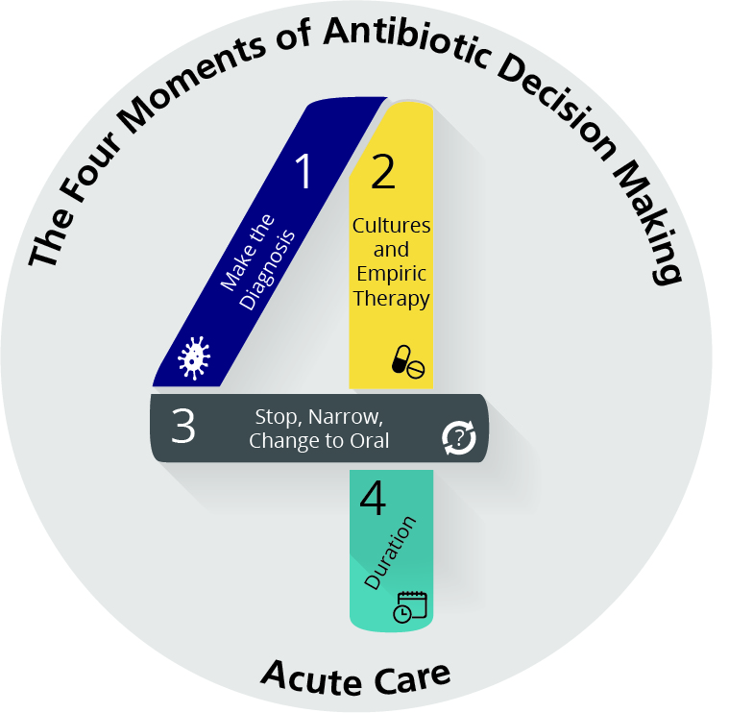
The Four Moments of Antibiotic Decision Making
Does my patient have an infection that requires antibiotics?
Have I ordered appropriate cultures before starting antibiotics? What empiric therapy should I initiate?
A day or more has passed. Can I stop antibiotics? Can I narrow therapy or change from IV to oral therapy?
What duration of antibiotic therapy is needed for my patient's diagnosis?
AHRQ, 2019

Slide 7
Antibiotic-Associated Adverse Events
AHRQ, 2019
Notes:
5

Slide 8
Adverse Outcomes with IV antibiotics in patients with heart failure
144 patients, retrospective, >18 yo diagnosed with acute decompensated heart failure
Excluded if pregnant, BNP <100, HD/CRRT, radiologist reported PNA (or question of), procalcitonin >0.25
88 (61%) no IVAB
56 (39%) yes IVAB
Patients in IVAB arm:
Had longer length of stays (primary outcome) 6.6 v 3d
required >2.5 x more Lasix (930mg v 320mg)
were 2.51x more likely to be readmitted
Frisbee, J and colleagues OFID, 2019
Notes:
Mean age was 71 (no abx), 73 (abx)
Median BNP was 1099, 927
1.7L average volume from antibiotic infusions alone

Slide 9
Notes:
Dr. Emeran Mayer- professor of psychiatry and medicine here at UCLA
Mayer thinks the bacteria in our digestive systems may help mold brain structure as we're growing up, and possibly influence our moods, behavior and feelings when we're adults.
Mayer found that the connections between brain regions differed depending on which species of bacteria dominated a person's gut. That suggests that the specific mix of microbes in our guts might help determine what kinds of brains we have — how our brain circuits develop and how they're wired.
One experiment involved replacing the gut bacteria of anxious mice with bacteria from fearless mice.
"The mice became less anxious, more gregarious," says Stephen Collins of McMaster University in Hamilton, Ontario, who led a team that conducted the research.
It worked the other way around, too — bold mice became timid when they got the microbes of anxious ones. And aggressive mice calmed down when the scientists altered their microbes by changing their diet, feeding them probiotics or dosing them with antibiotics.
A big nerve known as the vagus nerve, which runs all the way from the brain to the abdomen, was a prime suspect. And when researchers in Ireland cut the vagus nerve in mice, they no longer saw the brain respond to changes in the gut.

Slide 10
Empiric versus Targeted Treatment
Suspected infection
Culture sites
Microscopy
(Gram stain)
Identification
Culture &
Biochemical testing
Susceptibility testing
Start empiric antimicrobials
(usually broad-spectrum)
Definitive antimicrobials
Consider:
Syndrome (and likely pathogens)
Severity of illness
Known antimicrobial resistance factors
Contributing host factors (immunosuppressed)
48-72 hours
Courtesy Jen Curello, Pharm D
Notes:
Empiric treatment
Treatment of a proven or suspected infection where the infecting organism has not been identified
Definitive treatment
Treatment targeted towards a pathogen with known antimicrobial susceptibilities

Slide 11
Cohort Study
17430 adults with culture proven sepsis
Exposures: inadequate empiric antibiotic therapy (>1 resistant pathogen) or unnecessarily broad empiric antibiotics
Outcome measure: in-hospital mortality adjusted for disease severity and baseline
Rhee, C, JAMA Open Network, April 16, 2020

Slide 12
Rhee, C, JAMA Open Network, April 16, 2020

Slide 13
Rhee, C, JAMA Open Network, April 16, 2020

Slide 14
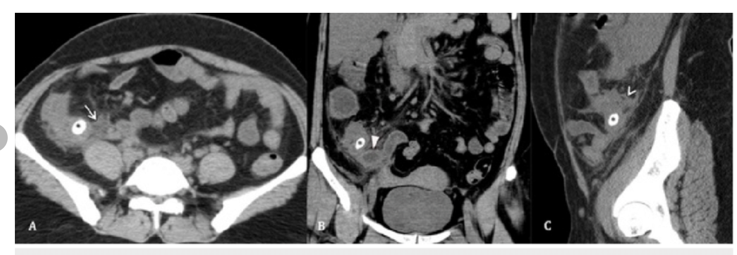
25-year-old M presents with LLQ abdominal pain
Presents with abdominal pain
Found to have appendicitis with appendicolith
Khan, Sohaib & Chaudhry, Mustafa & Shahzad, Noman & Khan, Muhammad & Wajid, Maryiam & Memon, Wasim & Alvi, Abdul. (2019). The Characteristics of Appendicoliths Associated with Acute Appendicitis. Cureus. 11. 10.7759/cureus.5322.

Slide 15
What would you do? What does it mean to “manage conservatively”?
Surgery alone
Antibiotics alone
Antibiotics and surgery
None of the above

Slide 16
CODA: Comparison of Outcomes of Antibiotic Drugs and Appendectomy
1552 adults randomized: 10 days antibiotics alone v surgery
No difference in primary outcome
European Quality of Life 5 Dimensions questionnaire
In the antibiotics group, 29% had undergone appendectomy by 90 days
41% of those with an appendicolith and 25% of those without an appendicolith
Complications were more common in the antibiotics group
8.1 vs. 3.5 per 100 participants; rate ratio, 2.28; 95% CI, 1.30 to 3.98
Those with an appendicolith (20.2 vs. 3.6 per 100 participants; rate ratio, 5.69; 95% CI, 2.11 to 15.38)
Those without an appendicolith (3.7 vs. 3.5 per 100 participants; rate ratio, 1.05; 95% CI, 0.45 to 2.43).
The CODA Collaborative. N Engl J Med 2021;385:2395-2397.

Slide 17
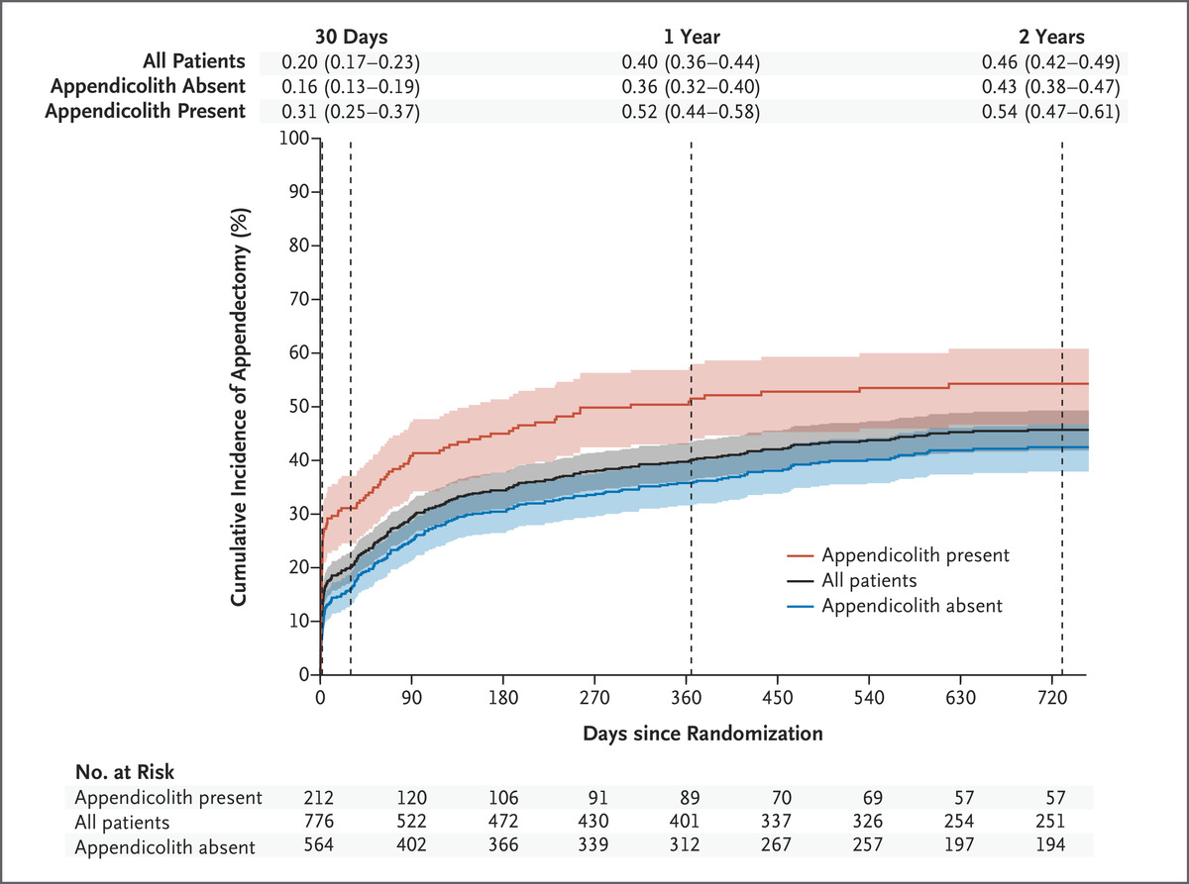
Cumulative Incidence of Appendectomy among Patients in the Antibiotics Group, According to the Presence or Absence of an Appendicolith.
3 out of 10 had undergone appendectomy in 90 days
6 out of 10 didn’t!
The CODA Collaborative. N Engl J Med 2021;385:2395-2397.
Notes:
Figure 1. Cumulative Incidence of Appendectomy among Patients in the Antibiotics Group, According to the Presence or Absence of an Appendicolith. Shown is the cumulative incidence of appendectomy in the patients with appendicitis within 2 years after randomization among those who were assigned to receive antibiotics. When the exact date of appendectomy was not reported by the patient or was not available in the patient’s chart, the median time between surveys was used as the estimated date of appendectomy. The shaded areas indicate 95% confidence intervals.

Slide 18
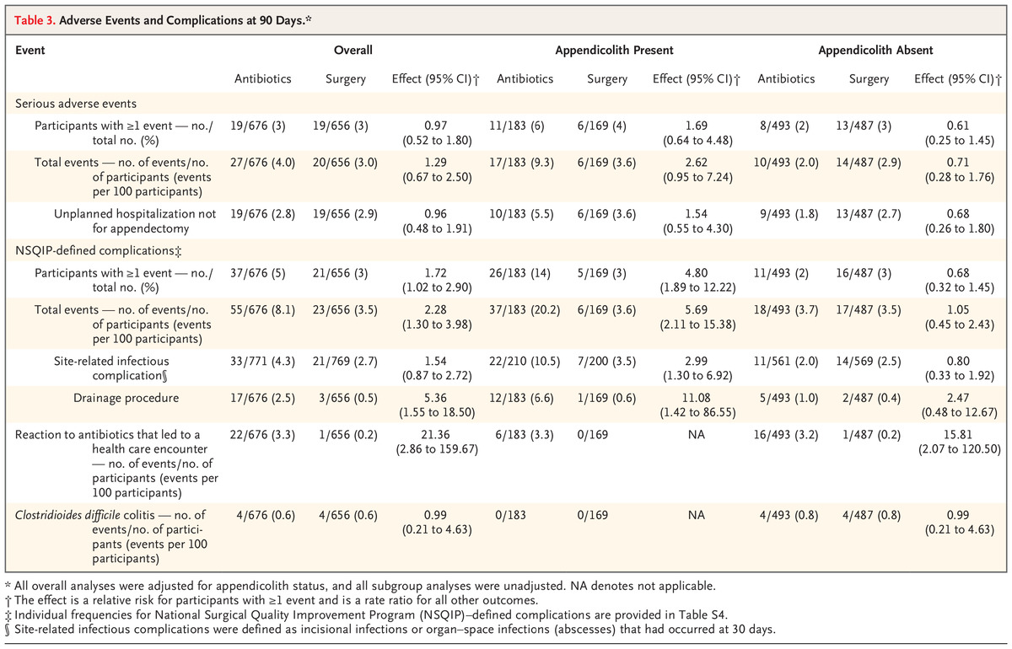
Adverse Events and Complications at 90 Days.*
The CODA Collaborative. N Engl J Med 2020;383:1907-1919.
Notes:
Table 3. Adverse Events and Complications at 90 Days. *

Slide 19
Adverse Events and Complications at 90 Days.*
The CODA Collaborative. N Engl J Med 2020;383:1907-1919.
Notes:
Table 3. Adverse Events and Complications at 90 Days. *

Slide 20
What empiric antibiotics would you choose for a patient with a complicated IAI?

Slide 21
Human Microbiome
Notes:
TV

Slide 22
Antibiotics for complicated intraabdominal infections
amox-clav
cefpodoxime PLUS metronidazole
ciprofloxacin PLUS metronidazole
ertapenem v piperacillin tazobactam
meropenem or Imipenem
Anti carbapenemase drugs: meropenem-vaborbactam, imipenem relebactam, ceftolazone-tazobactam (plus metronidazole), ceftazidime-avibactam (plus metronidazole), cefiderocol (plus metronidazole), tigecycline

Slide 23
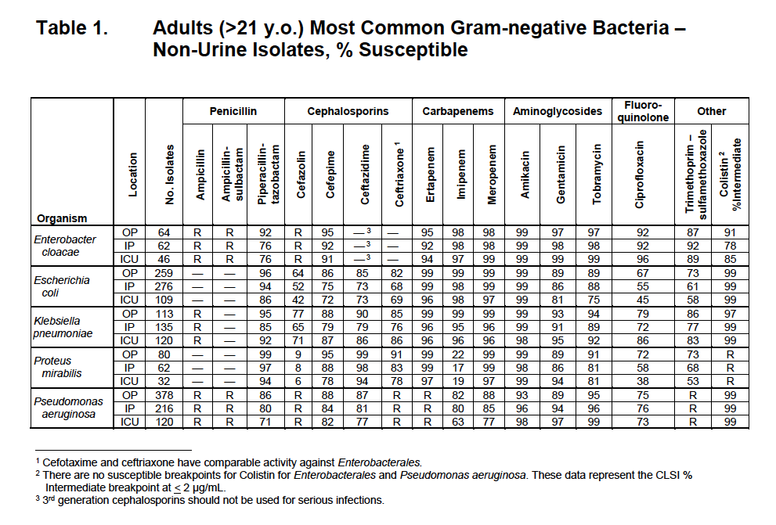

Slide 27
He presents with fevers two weeks later
He is started on amoxicillin-clavulanate for 9 days after receiving piperacillin-tazobactam for a day.
1 week after stopping his antibiotics he develops new fevers and a repeat image shows a 3cm abscess which undergoes IR guided drainage. He is started on ceftriaxone and metronidazole.

Slide 28
When would you stop his antibiotics?
Stop now, source control has been achieved
Stop in 4 days
Stop in 14 days
Stop after drain is pulled
Stop 2 weeks after drain is pulled

Slide 29
518 patients randomized
2 days after resolution of fever or 10 days max v 4 days
Primary outcome: surgical site infecitons or recurrent intraabdominal infection or death within 30 days of source control procedure
Results: 21.8% v 22.3% met primary outcome
Sawyer, NEJM 2015
Notes:
Control group 10 days max, 2 days after resolution of SIRS
Experimental: 4 days after source control

Slide 30
When do we use antifungals?
If clinically worsening on current course and source has been controlled
If colonized at more than 2 sites (sputum, urine) and not improving
Never take a culture from an old drain and use this to guide your clinical decision making

Slide 31
The Antibiotic Course Has Had Its Day
Florey and colleagues
Patient with Staph sepsis did not respond to PCN
Tried to keep giving him penicillin by recovering drug from his urine
Assumption that he just needed more (not that it was resistant)
Fleming in 1945 Nobel speech:
”If you use penicillin, use enough!”
Clinical vignette: ”resistant” strep
World Health Organization: Antibiotic Awareness Week 2016
“always complete the full prescription, even if you feel better, because stopping treatment early promotes the growth of drug resistant bacteria”
Llewelyn and colleagues. BMJ 2017;358:j3418 doi

Slide 32
Llewelyn and colleagues. BMJ 2017;358:j3418 doi

Slide 33
Given that shorter is better, what about perioperative antibiotics?
All antimicrobials administered within 1 hour prior to incision unless otherwise indicated and 1 dose recommended for clean/clean contaminated (unless duration of surgery exceeds dosing interval­).
Total duration of antibiotics not to exceed 24 hours post-op
UCLA Health Perioperative Guidance, 2022

Slide 34
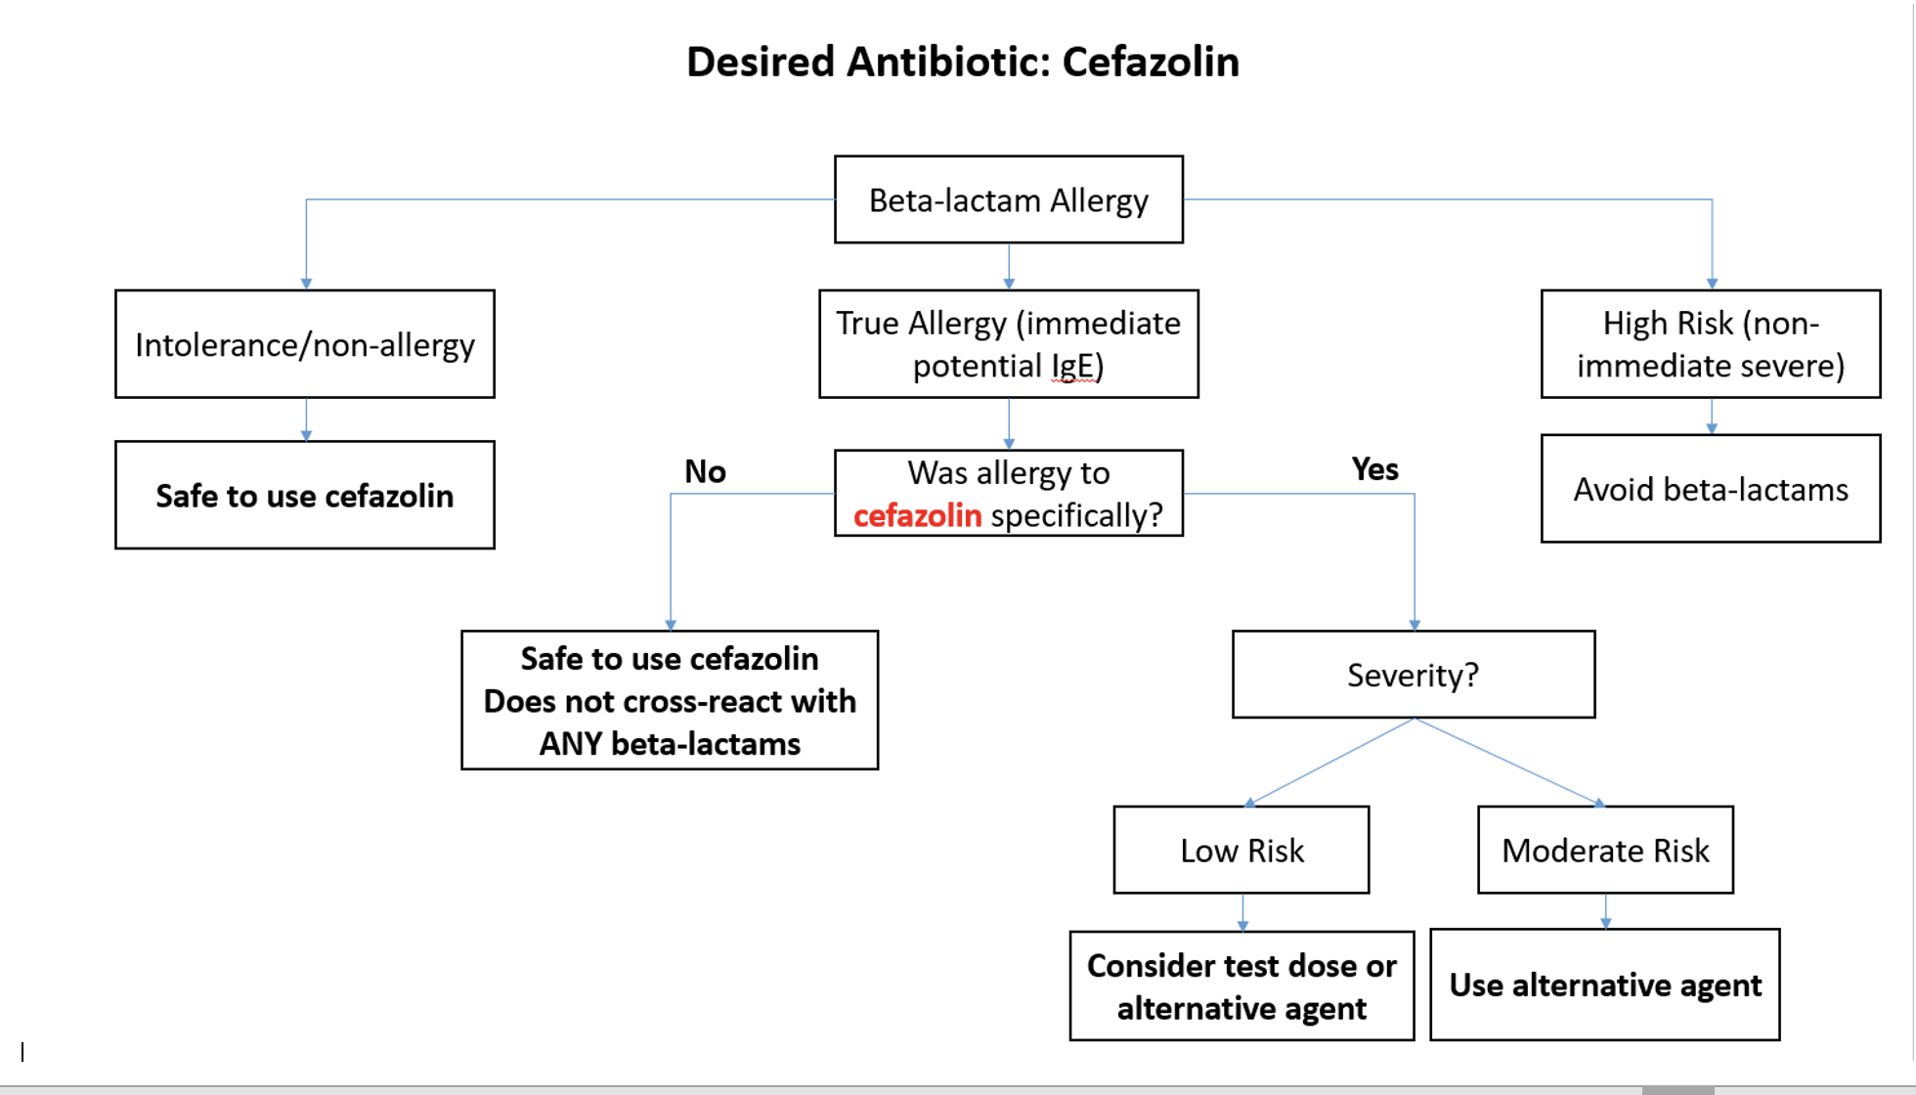
UCLA Health Perioperative Guidance, 2022

Slide 35
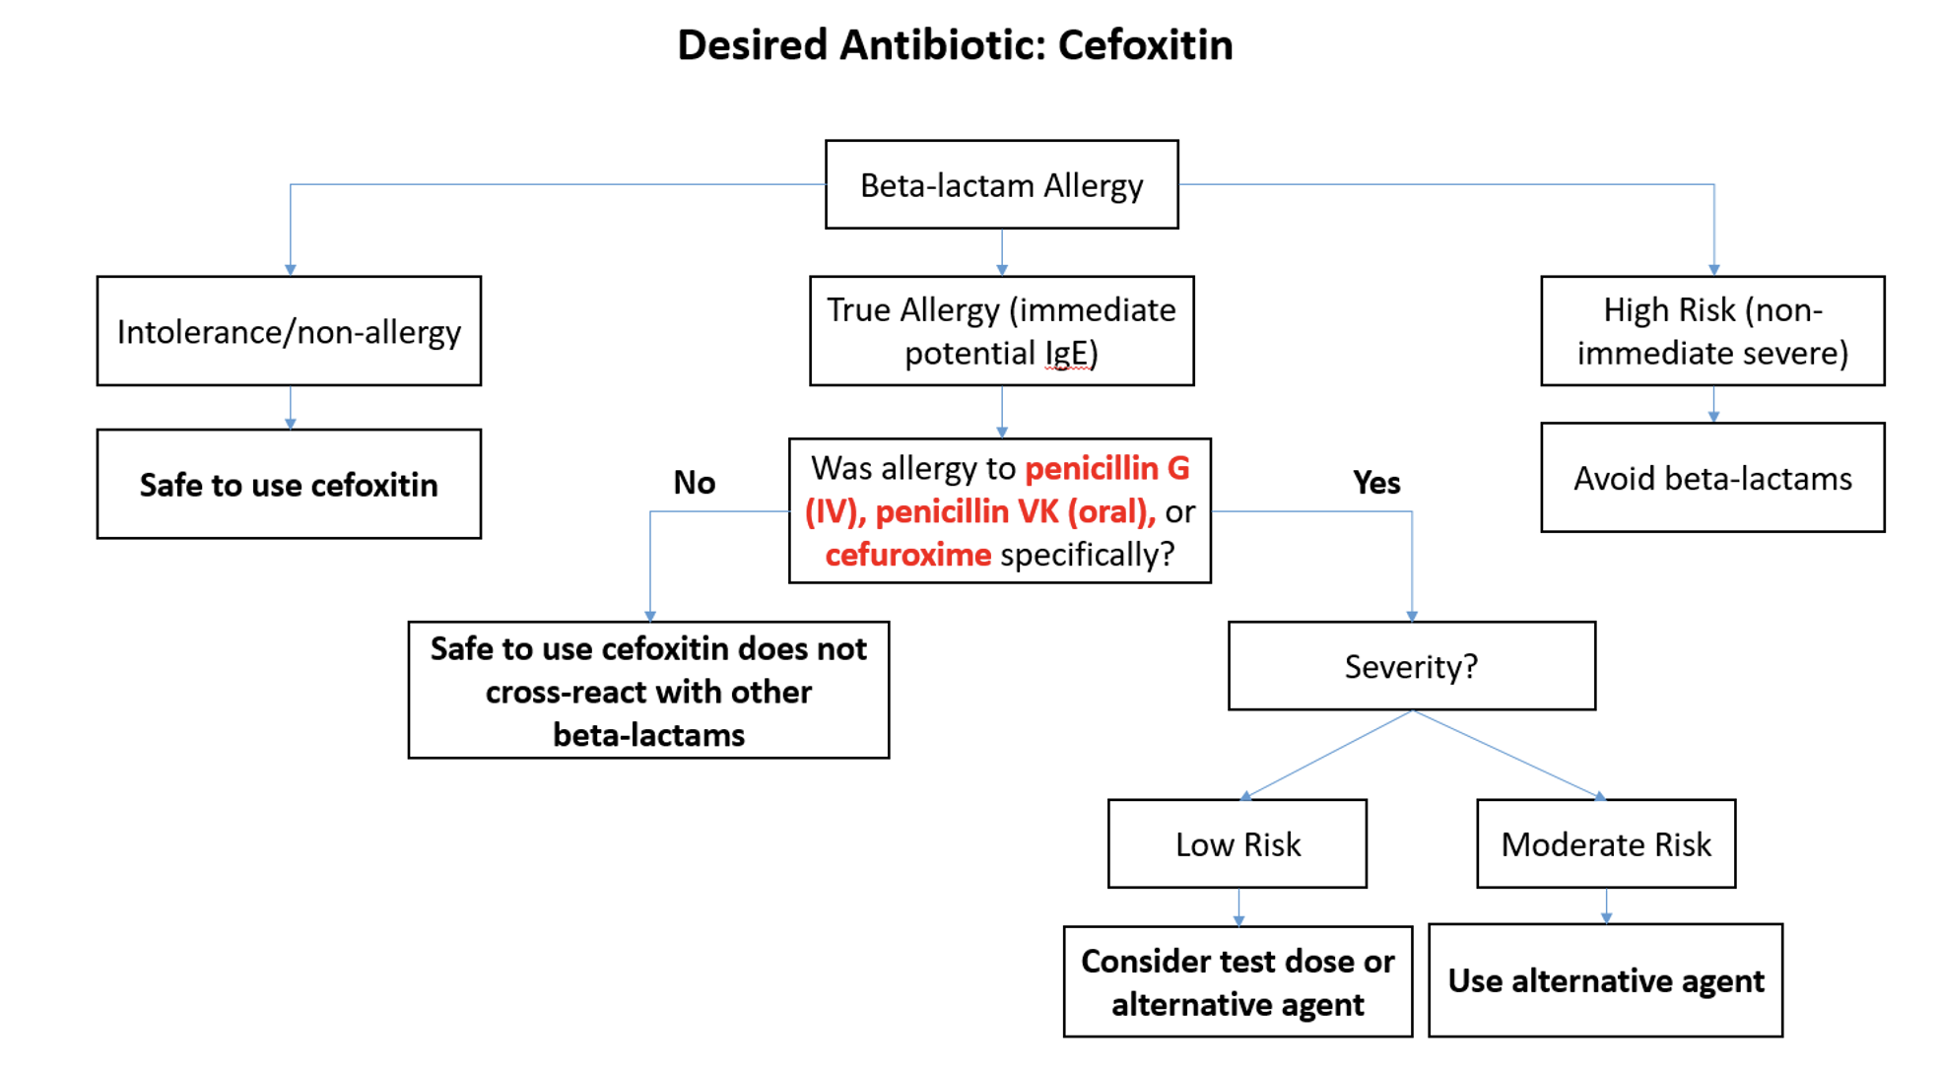
UCLA Health Perioperative Guidance, 2022

Slide 36
UCLA Health Perioperative Guidance, 2022

Slide 37
67-year-old woman who resides in SNF
Admitted from SNF with fever and altered mental status
Recent viral infection with bronchitis
Recently had episode of small bowel obstruction, managed conservatively
Hospital course complicated by stroke with some dysphagia
VS: 38.4, 100/77, 90, 22, O2 sat 93%
Chest x-ray shows RLL infiltrate
Urinanalysis shows 30 WBCs, 2 squamous cells

Slide 38
What antibiotics would you use?
Ceftriaxone and azithromycin
Vancomycin, Ceftriaxone, Azithromycin
Pip-tazo
Vancomycin, pip-tazo and azithromycin

Slide 39
What about covering anaerobes (aspiration)?
Piperacillin tazobactam
Ertapenem
Metronidazole
Ceftriaxone! (covers usual oral anaerobes)

Slide 40
Duration of therapy for VAP
Community Acquired Pneumonia: 5 days
If they are not getting better in 48-72 hours consider what else
Hospital Acquired Pneumonia: 7 days
Chastre Study on VAP: Prospective RCT
51 French ICUs, 401 patients evaluated
No difference in mortality or recurrence of infection overall
Lactose non-fermenters may have had higher recurrence rate but no difference in mortality
Notable: among those with recurrence of infection, shorter course had less resistance (42% vs 62%)

Slide 41
How do we choose which antibiotics?
Risk factors for MDR (harder to ascertain than we realize)
DEFINITELY recurrent or prolonged use of antibiotics
Prior history of MDR (including opportunistic pathogens like Pseudomonas)
Severity of illness? Maybe for MRSA ( MRSA nares!)
Co-morbid conditions? Not really.
Patient level factors:
feasibility of multiple doses, benefit of extended infusions
There is really no magic to IV antibiotics with respect to efficacy
Exception is MRSA in blood
We are losing efficacy of many orals due to MDR

Slide 42
MRSA Nares Per Pharmacy – Clinical Literature

Slide 43
MRSA Nares Per Pharmacy – Clinical Literature

Slide 45
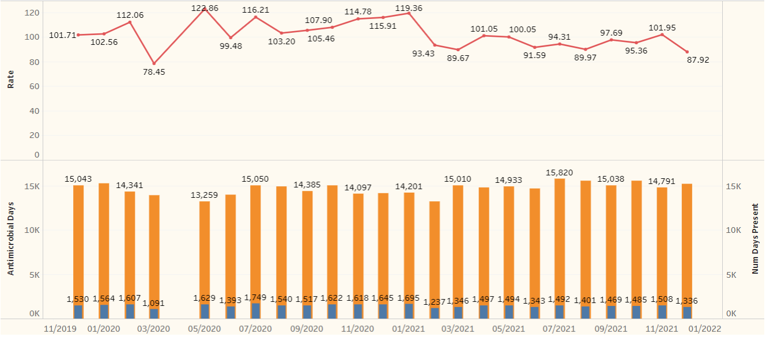
MRSA Nares Per Pharmacy – Vancomycin Use
COVID-19 outlier
Go-live and
education
Vancomycin rate decreased by 12.9% in the 8 month pre/post-implementation periods at RRMC hospital
Christine Pham, PharmD

Slide 46
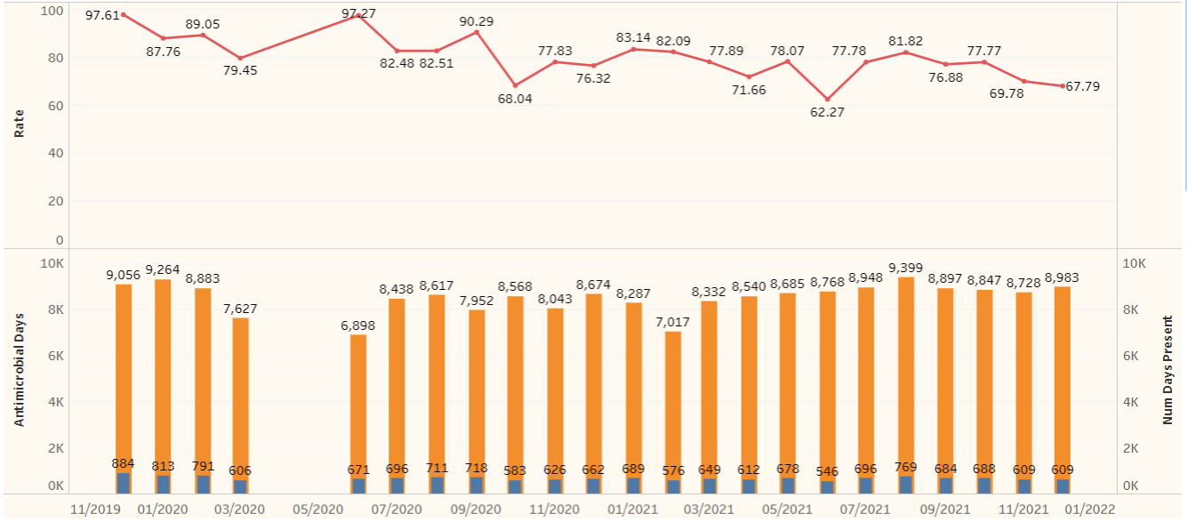
MRSA Nares Per Pharmacy – Vancomycin Use
COVID-19 outlier
Go-live and
education
Vancomycin rate decreased by 15.7% in the 8 month pre/post-implementation periods at SMH hospital
Christine Pham, PharmD

Slide 47
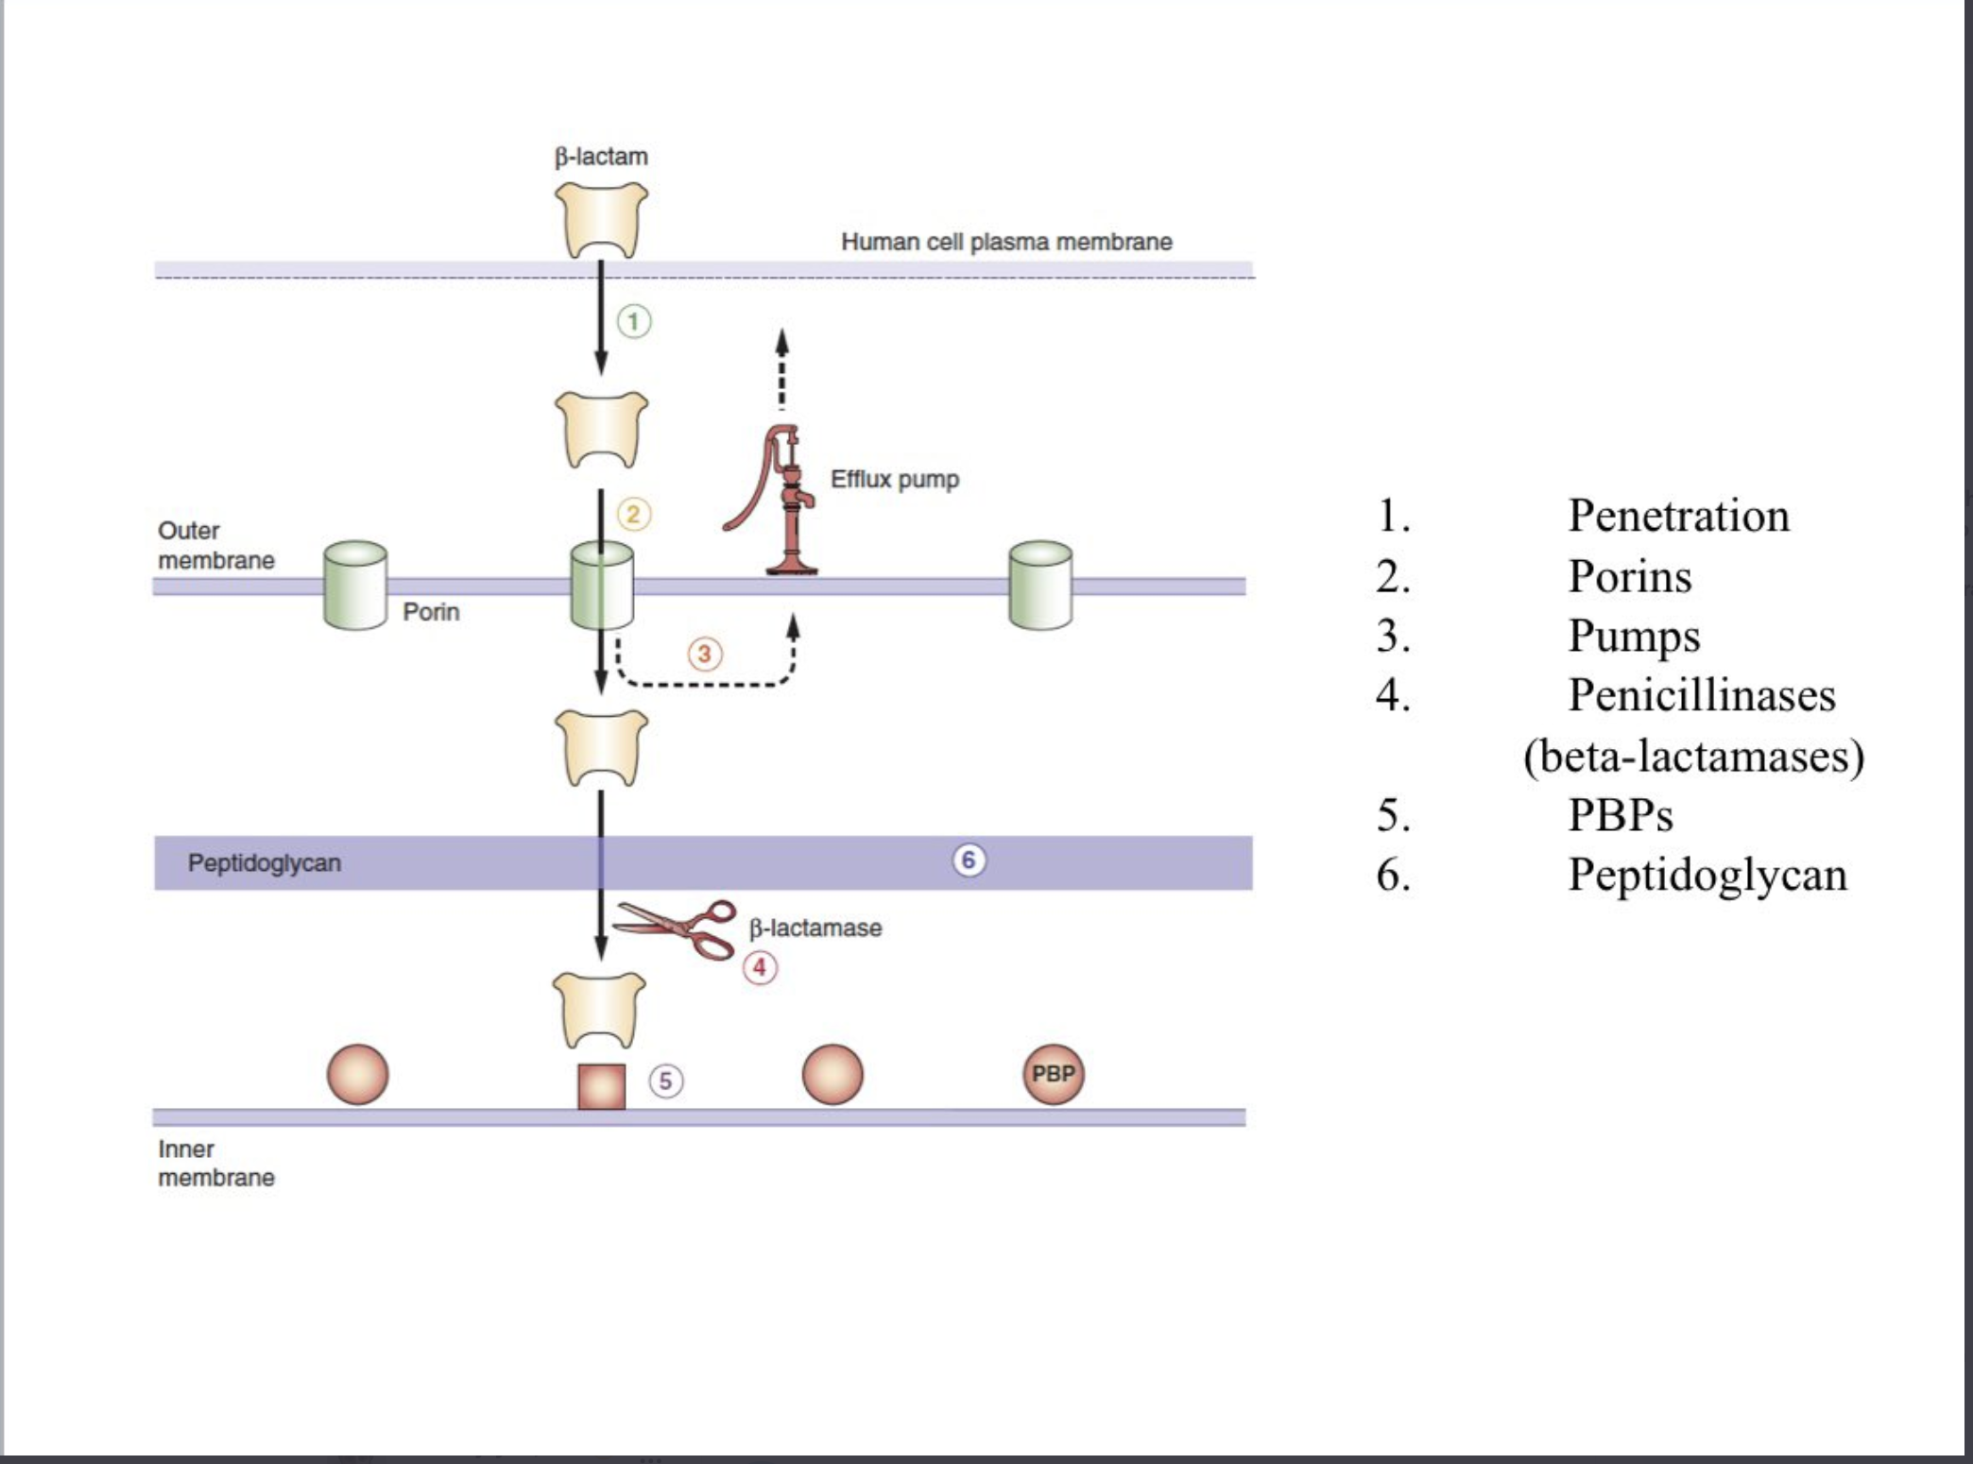
The big beasts of ID: ESBL, CRE, other MDROs
Amp C producers: historically “SPICE/SPACE”, but now just Enterobacter cloacae, Citrobacter freundii, Klebsiella aerogenes
Avoid ceftriaxone
Cefepime and ertapenem are first line
ESBL= extended spectrum beta lactamases
Ertapenem
CRE= carbapenem resistant enterobacterales
OXA-48, KPC, NDM
Call ID
Notes:
AmpC β-lactamases are class C serine β-lactamase enzymes that can be produced by a number of Enterobacterales and glucose non-fermenting Gram-negative organisms. AmpC production in Enterobacterales generally occurs by one of three mechanisms: inducible chromosomal resistance, stable chromosomal de-repression, or via plasmid-mediated ampC genes

Slide 48
Strategies used by Antimicrobial Stewardship Programs
Prospective Audit and Feedback
Antibiotic Time Outs
Pre-authorization
”Protected” (Restricted) Antibiotics
Shorten duration
De-escalation
Switch from IV to po

Slide 49
Orals versus IV- the great debate

Slide 50
POET divergence of mortality: it is probably not the meds
3.5 years: 16% v 27% mortality
5 years: 23% v 35% mortality
Spellberg, 2022

Slide 51
Take home points
Antibiotics are amazing! Antibiotics save lives!
Antibiotics are terrible! (side effects, resistance)
Everyone can be a steward!
Stop antibiotics when not needed
Shorten duration
Switch from IV to po when you can
De-escalate (broad → narrow) by targeted therapy

Slide 52
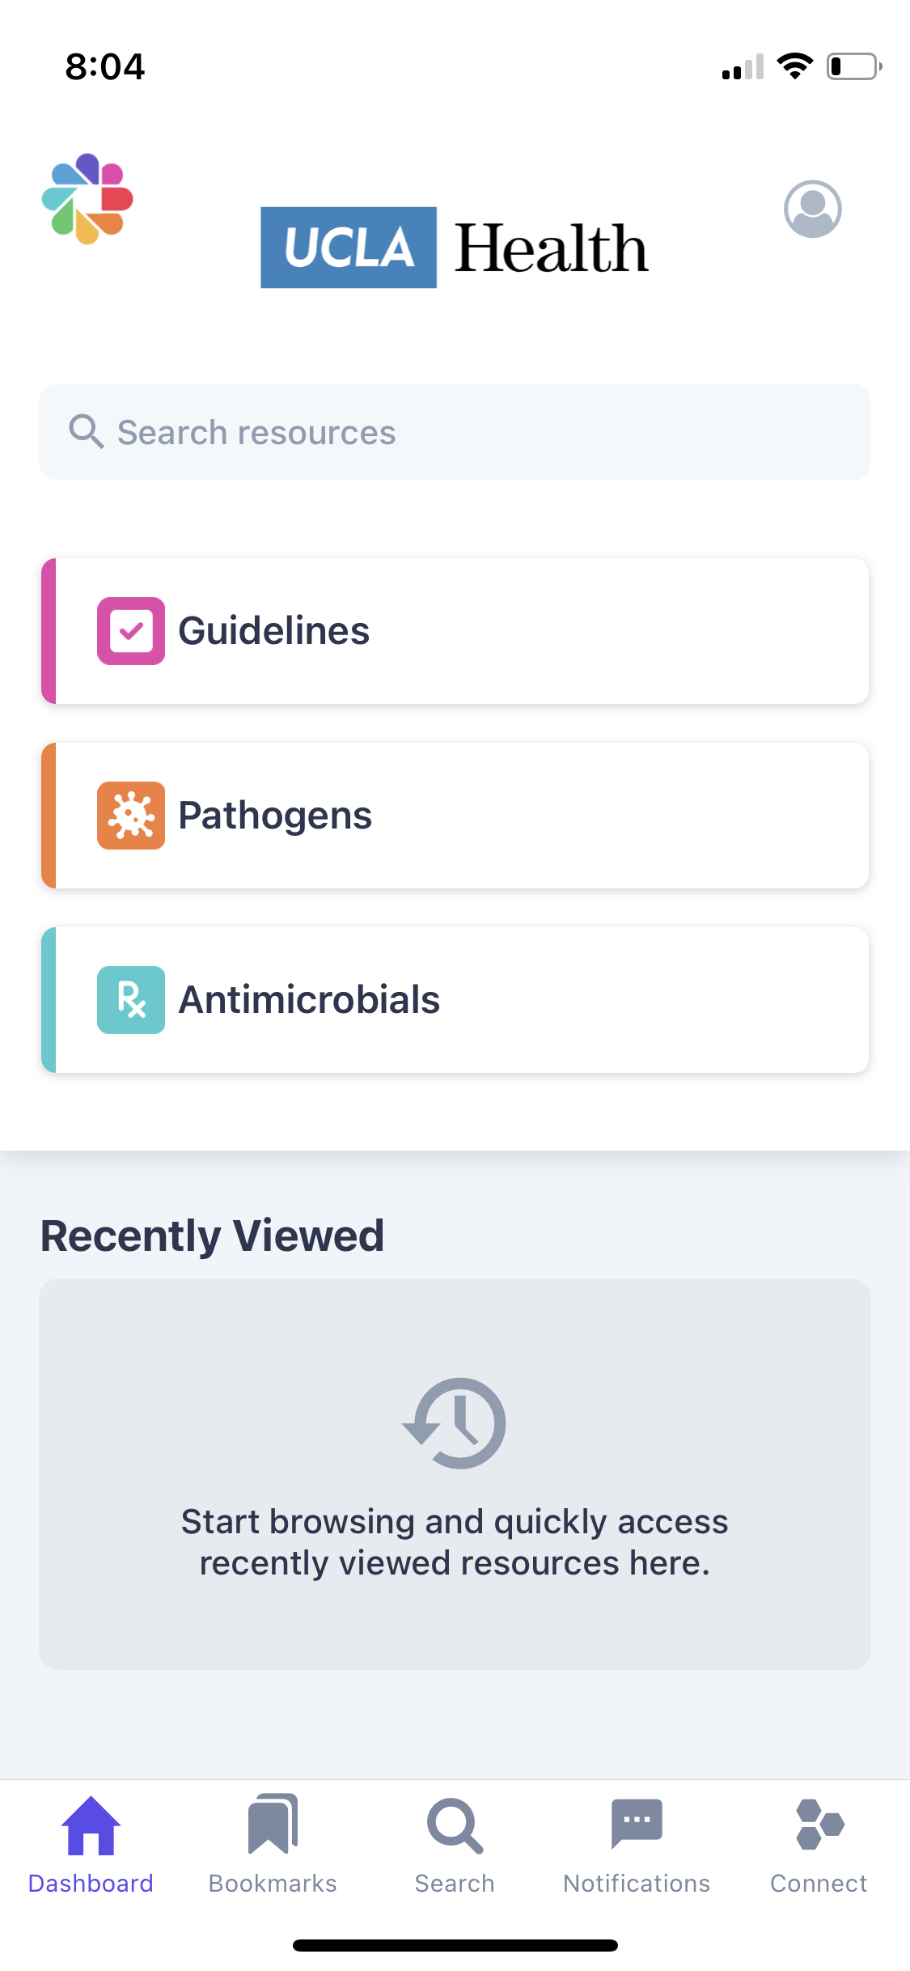
Thank you! Check out asp.mednet.ucla.edu and download Firstline app

